Slide 1
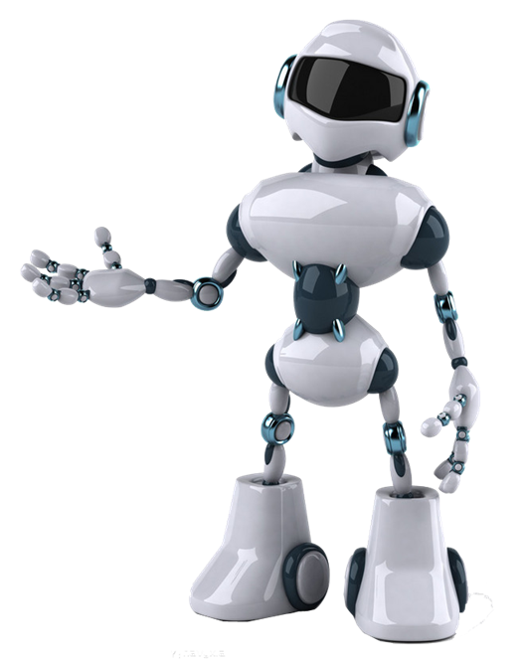
LANE LINE DETECTION

Slide 2
PIPELINE ARCHITECTURE
Load test images.
Apply Colour Selection
Apply Canny edge detection.
Apply gray scaling to the images.
Apply Gaussian smoothing.
Perform Canny edge detection.
Determine the region of interest.
Apply Hough transform.
Average and extrapolating the lane lines.
Apply on video streams.

Slide 3
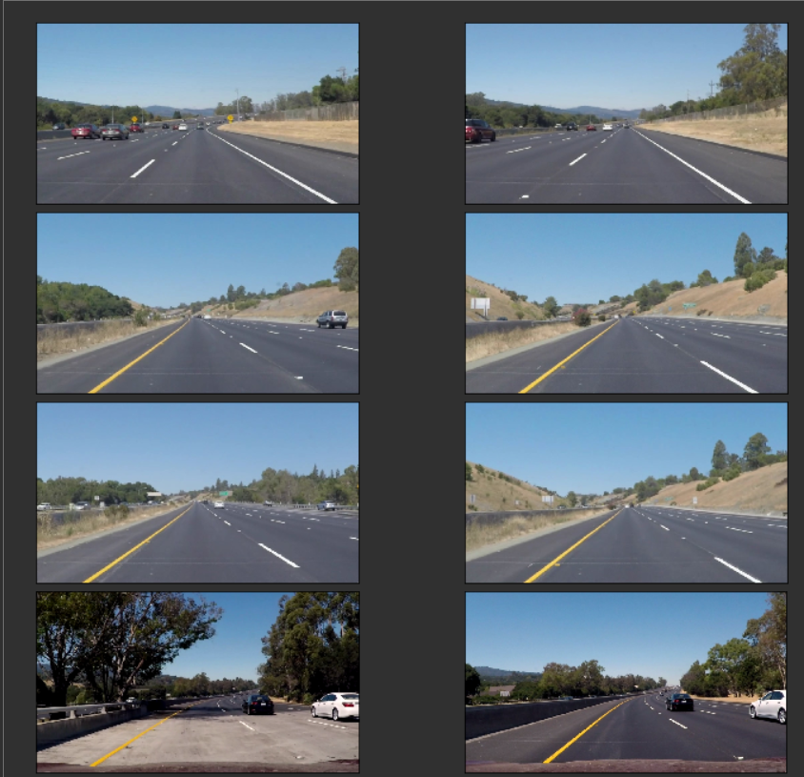
Loading test images

Slide 4
COLOR SELECTION
Lane lines in the test images are in white and yellow. We need to choose the most suitable color space, that clearly highlights the lane lines.
Original RGB color selection
I will apply color selection to the test_images in the original RGB format. We will try to retain as much of the lane lines as possible, while blacking out most of the other stuff.

Slide 5
HSV COLOR
HSV is an alternative representation of the RGB color model. The HSV representation models the way colors mix together, with the saturation dimension resembling various shades of brightly colored paint, and the value dimension resembling the mixture of those paints with varying amounts of black or white.

Slide 6
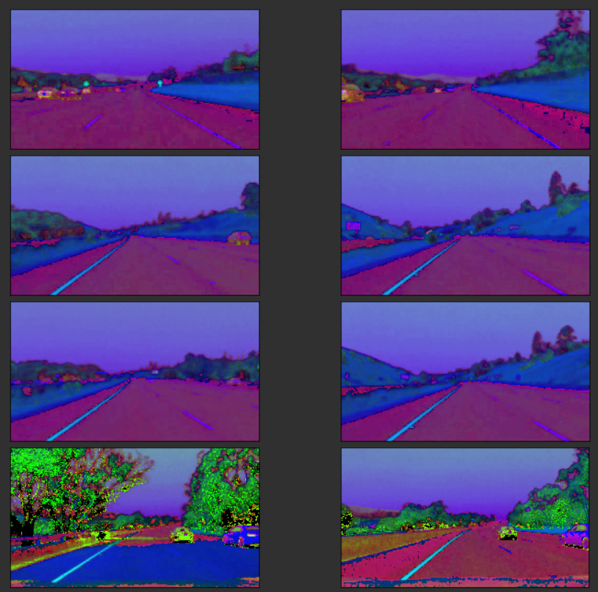
HSV TEST IMAGES

Slide 7
HSL COLOR
HSL is an alternative representation of the RGB color model. The HSL model attempts to resemble more perceptual color models such as NCS or Munsell, placing fully saturated colors around a circle at a lightness value of 1/2, where a lightness value of 0 or 1 is fully black or white, respectively.

Slide 8
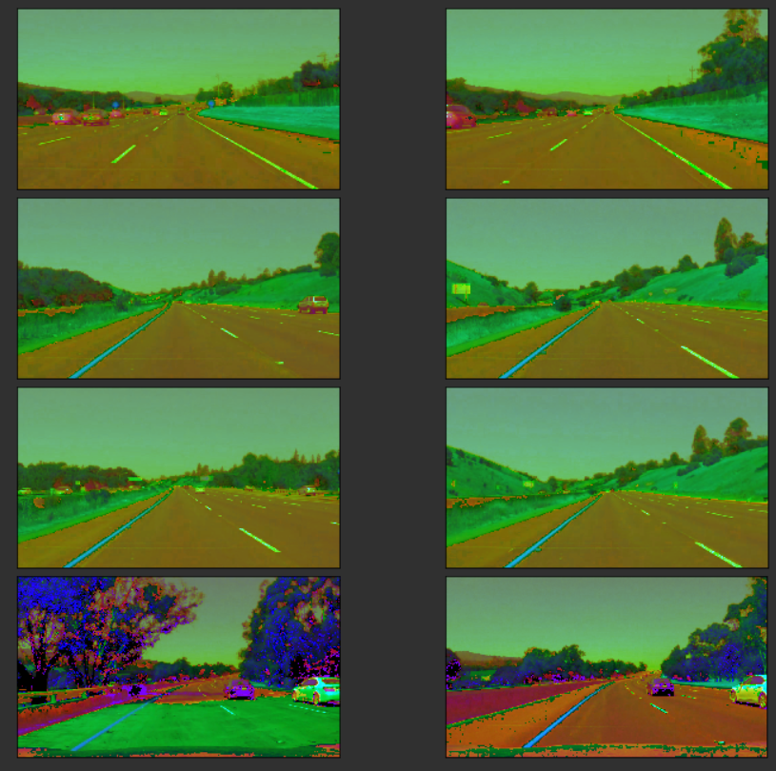
HSL TEST IMAGES

Slide 9
CANNY EDGE DETECTION
The Canny edge detector is an edge detection operator that uses a multi-stage algorithm to detect a wide range of edges in images.
a) Gray scaling the images
The Canny edge detection algorithm measures the intensity gradients of each pixel. So, we need to convert the images into gray scale in order to detect edges.

Slide 10
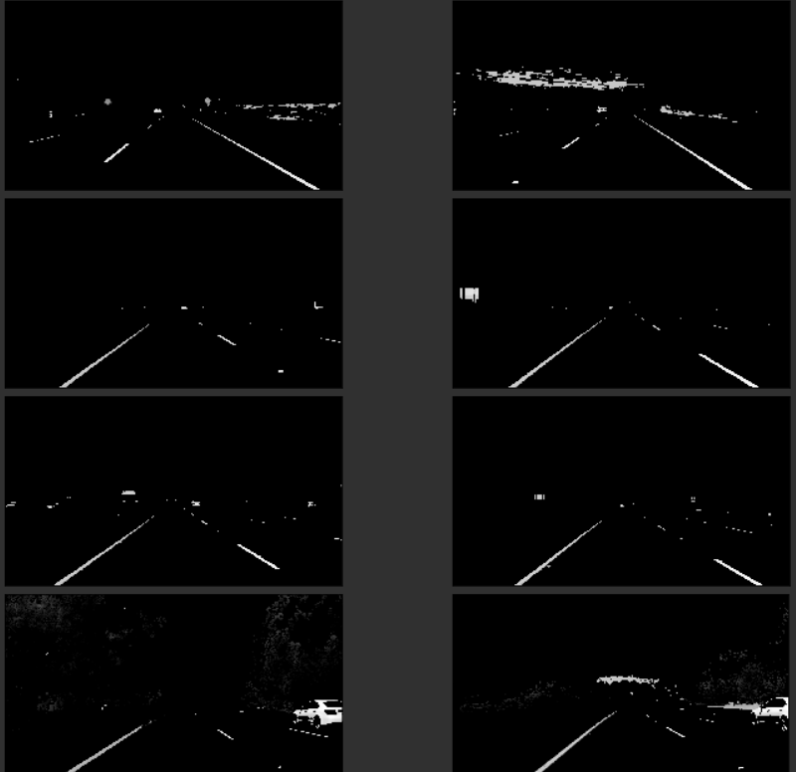
GRAY SCALE IMAGES

Slide 11
Applying Gaussian smoothing
Since all edge detection results are easily affected by image noise, it is essential to filter out the noise to prevent false detection caused by noise. To smooth the image, a Gaussian filter is applied to convolve with the image. This step will slightly smooth the image to reduce the effects of obvious noise on the edge detector.

Slide 12
GUASSIAN SMOOTHING IMAGES

Slide 13
Applying Canny Edge Detection
The Process of Canny edge detection algorithm can be broken down to 5 different steps:
Find the intensity gradients of the image
Apply non-maximum suppression to get rid of spurious response to edge detection.
Apply double threshold to determine potential edges.
Track edge by hysteresis: Finalize the detection of edges by suppressing all the other edges that are weak and not connected to strong edges.

Slide 14
REGION OF INTREST AND HOUGH TRANSFORM
Region of interest:
We're interested in the area facing the camera, where the lane lines are found. So, we'll apply region masking to cut out everything else.
Hough Transform:
The Hough transform is a technique which can be used to isolate features of a particular shape within an image. I'll use it to detected the lane lines in selected_region_images.

Slide 15
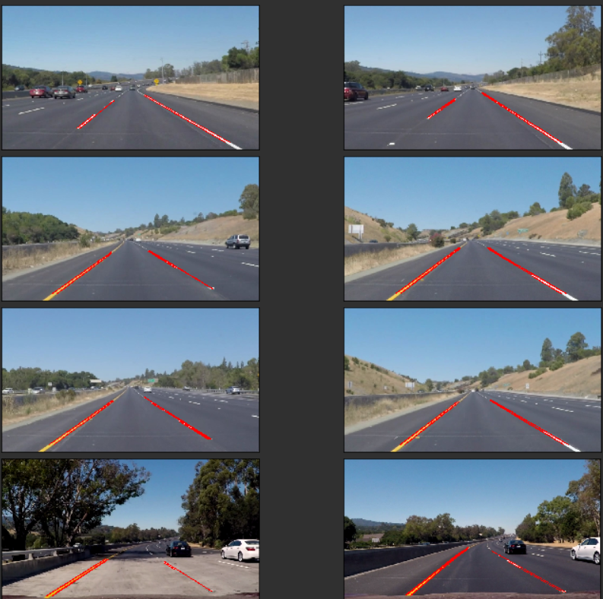
HOUGH TRANSFORM IMAGES

Slide 16
Averaging and extrapolating the lane lines
We have multiple lines detected for each lane line. We need to average all these lines and draw a single line for each lane line. We also need to extrapolate the lane lines to cover the full lane line length.
We'll use the above functions to detect lane lines from a video stream.

Slide 17
THANK YOU

